Slide 1
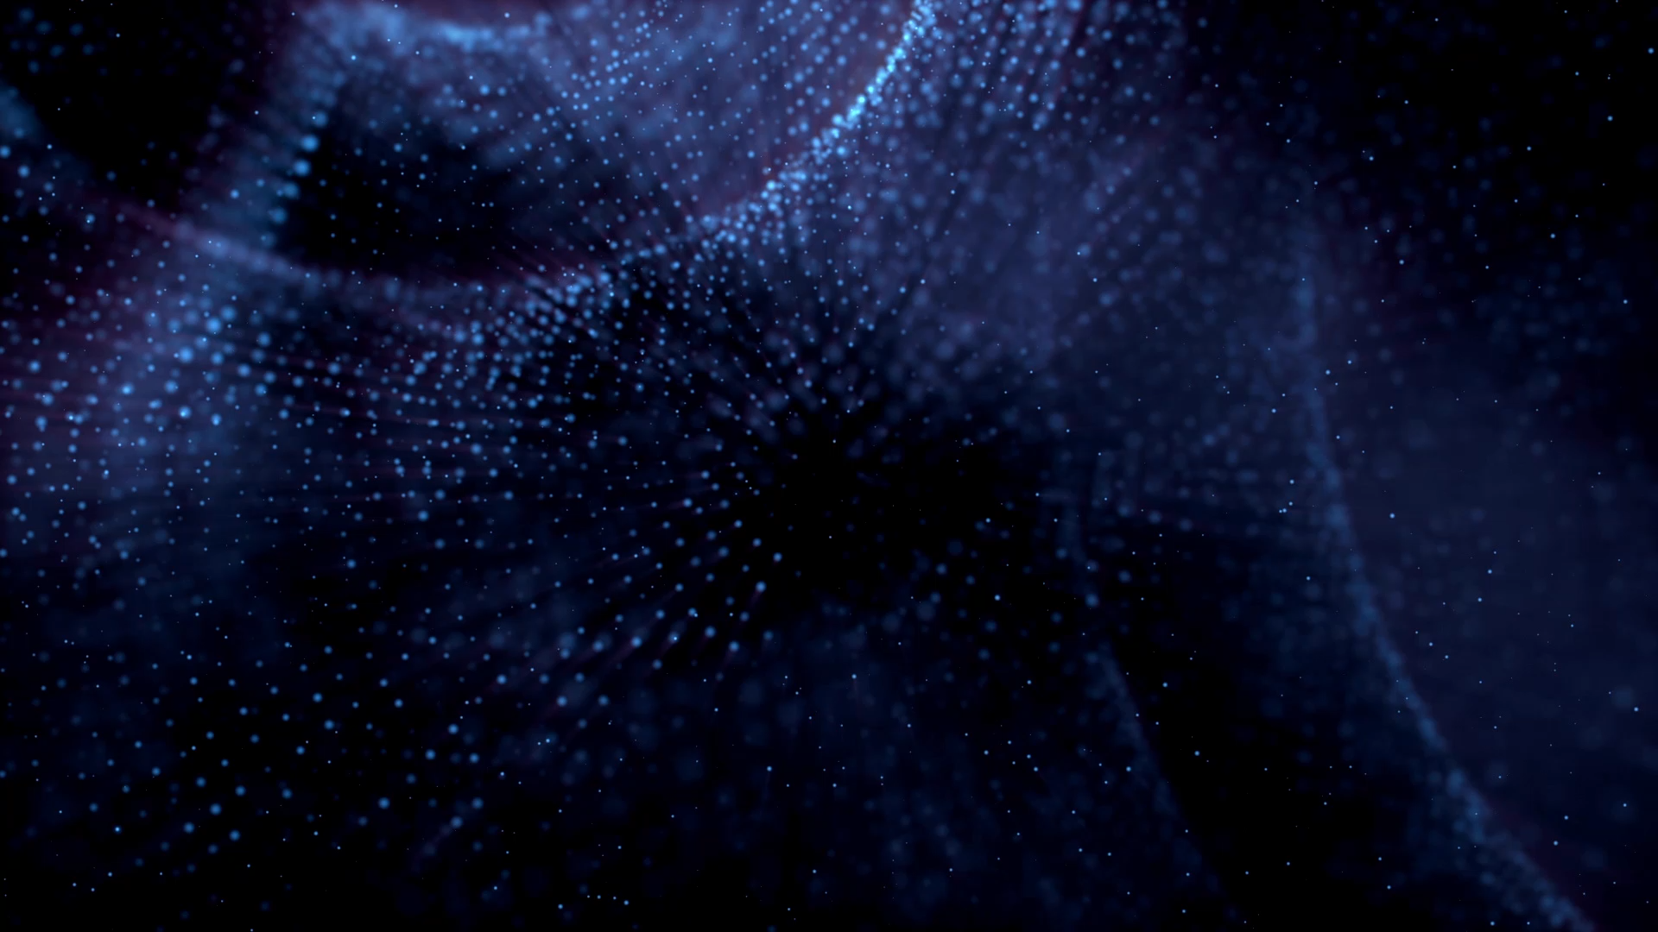

Neural Network and Deep Learning Course Final Project
Image Colorization using Conditional Generative Adversarial Networks X-ray
Prof. Jacopo Pegoraro
Asal Rangrasiasl - 2046832
Roya Joulaei- 2050954
Mojtaba Roshana – 2050955
20/02/2023

Slide 2


INTRODUCTION
AIM OF THE PROJECT
MATERIAL AND METHODS
DATASET
METHODOLOGY
RESULTS
CONCLUSION & QUESTIONS
CONTENTS

Slide 3
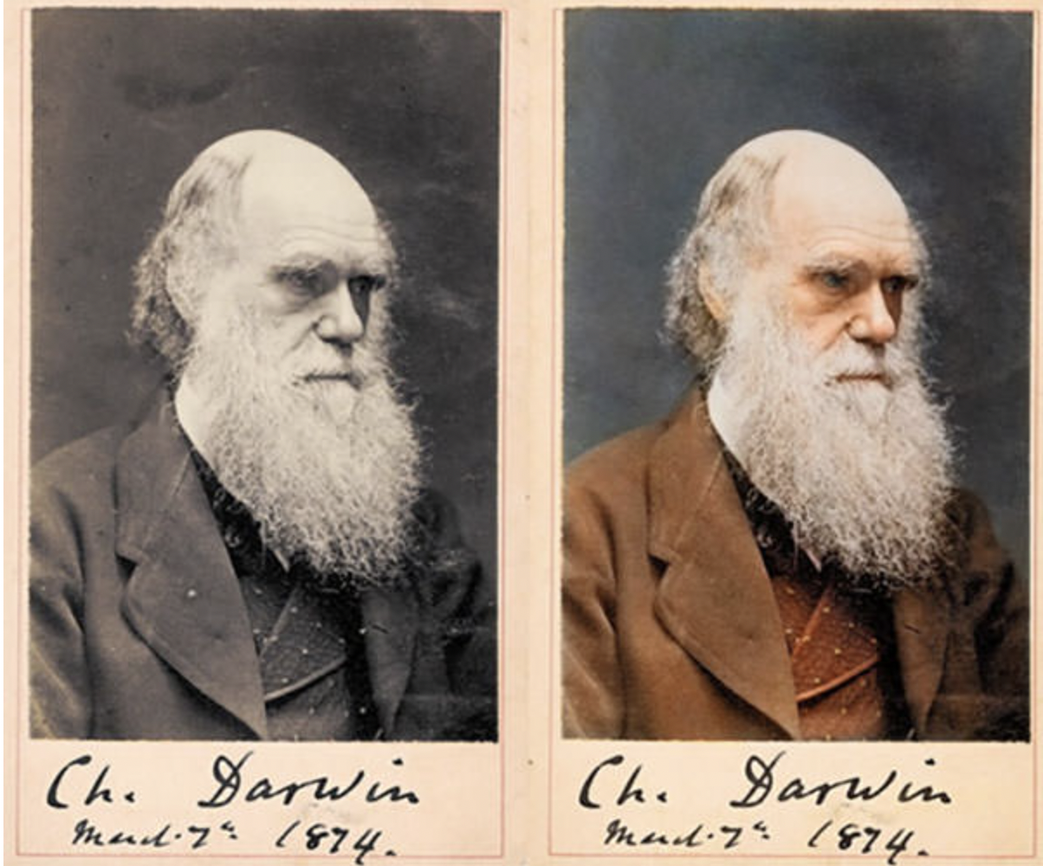
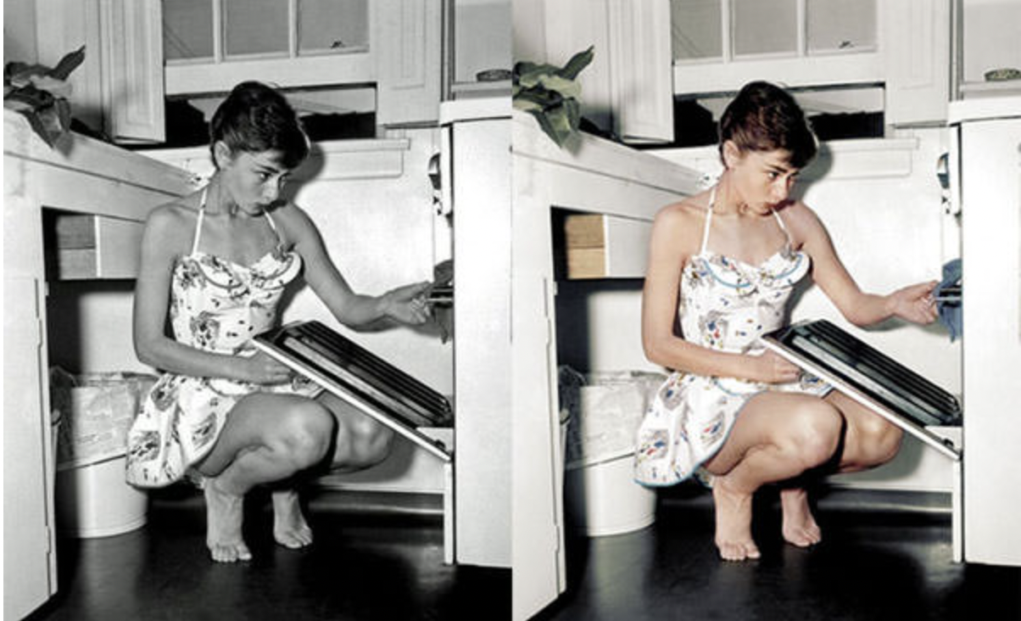
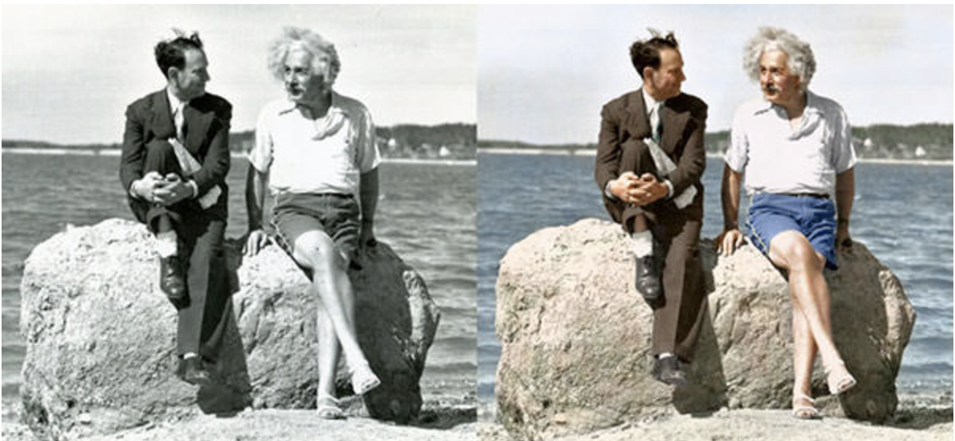
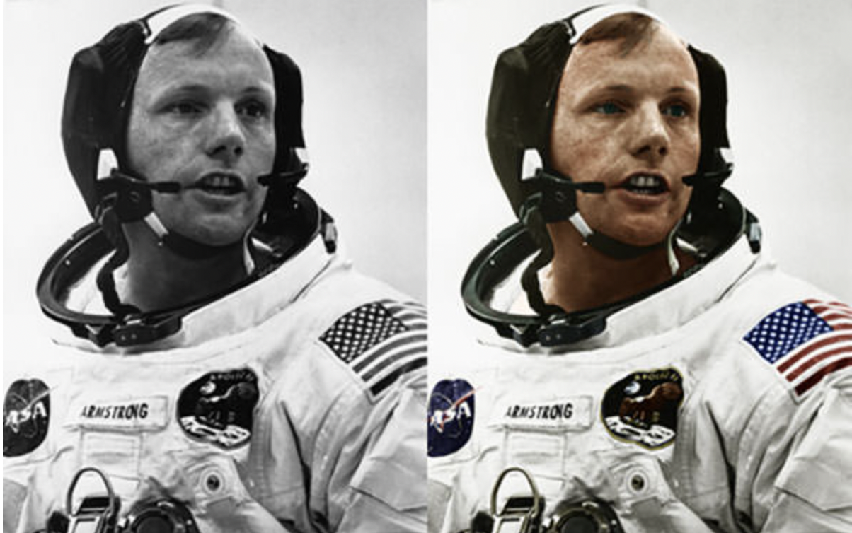
Image Colorization
image colorization can be a powerful tool for creating visually striking and emotionally engaging images that can be used in a variety of different contexts.

Slide 4
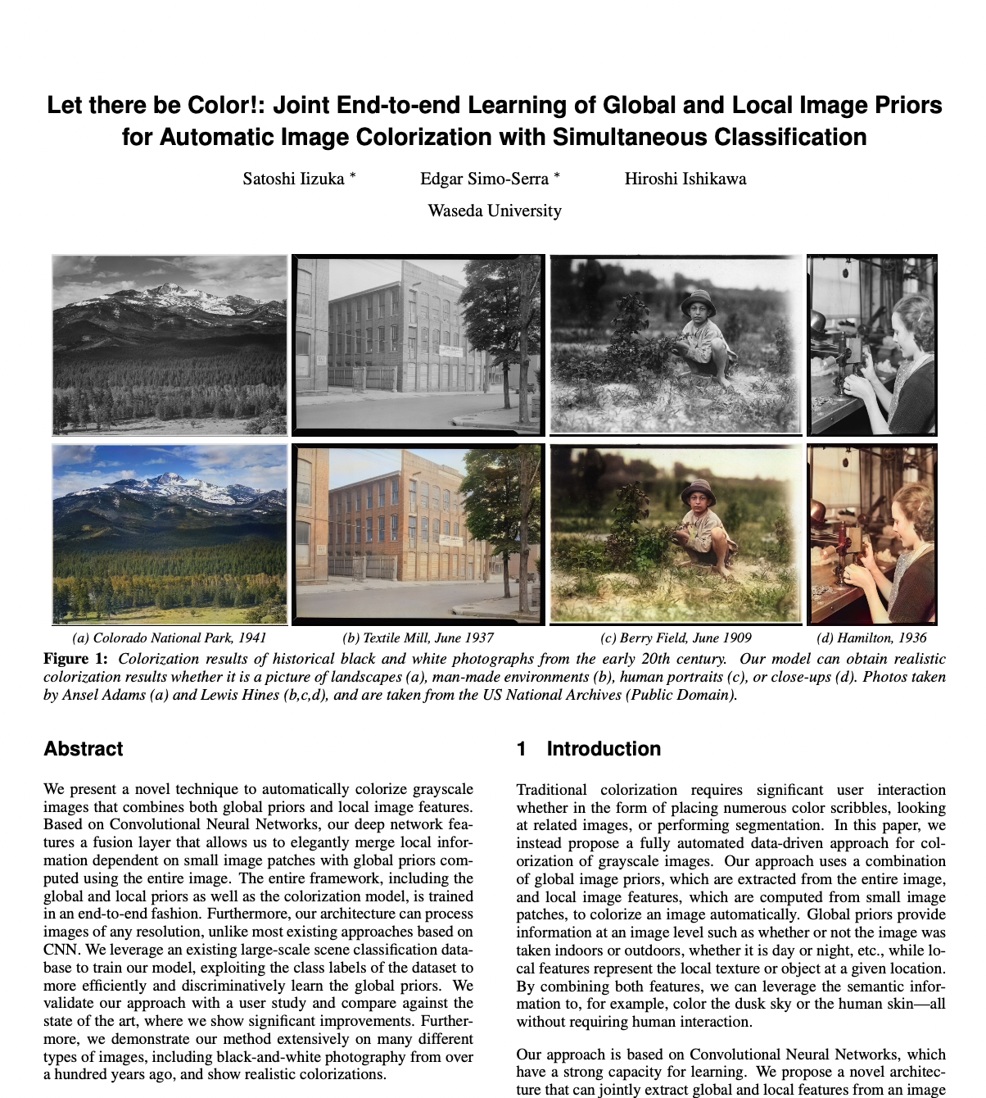
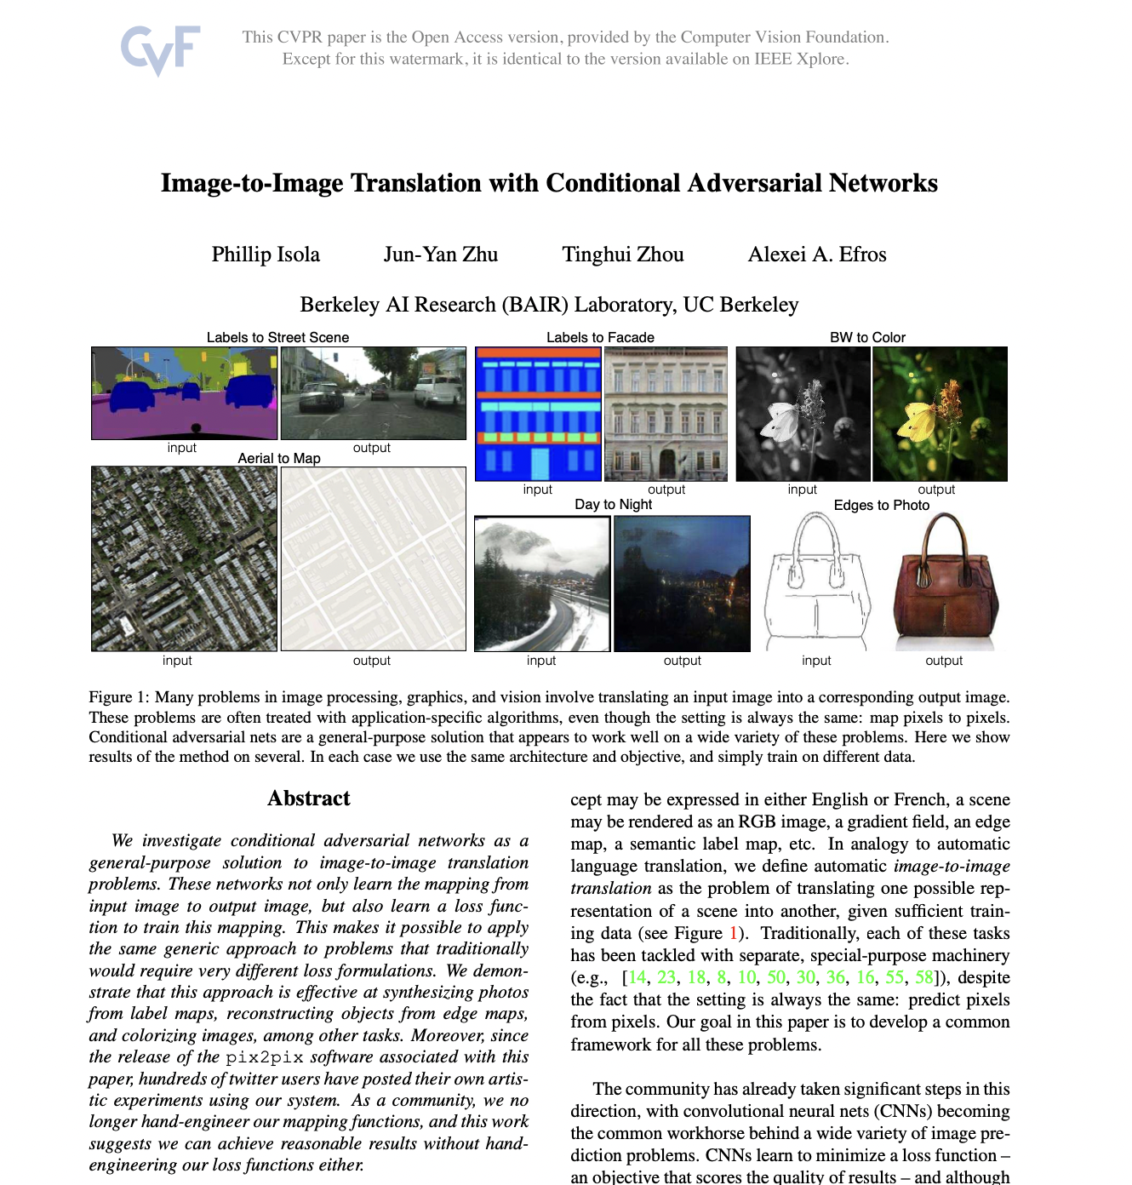
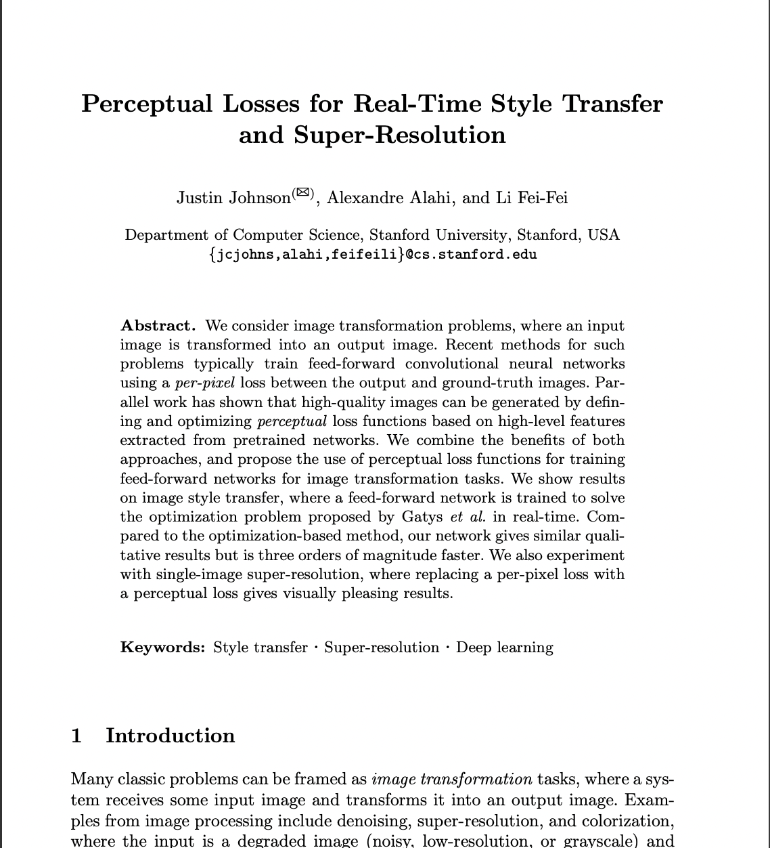
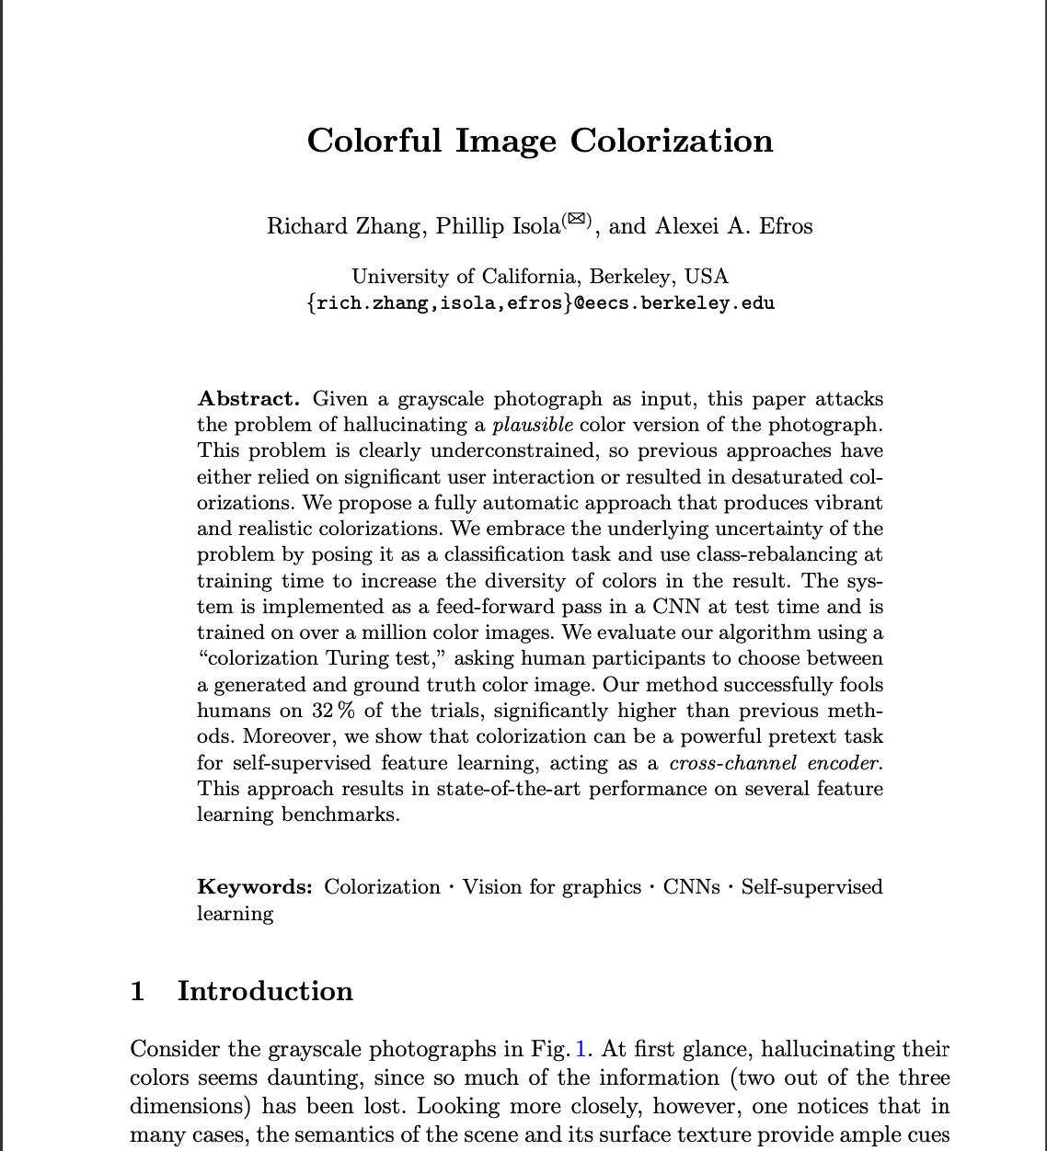
Related Works
Fully convolutional neural netowrk
CNN and inception-ResNet-V2
Cluster-based-method (K-means)
cGAN

Slide 5
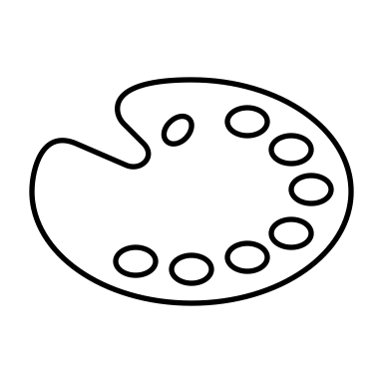


INTRODUCTION
we will explore the method of colorization using Conditional GAN (cGANs) proposed by Goodfellow et al.In deep generative modeling, deep neural networks learn a probability distribution over a given set of data points and generate similar data points
we use Lab color space instead of RGB to train the models because To train a model for colorization, we should give it a grayscale image and hope that it will make it colorful.
we use a UNet-based architecture for the generator, and using a
convolutional PatchGAN for the discriminator.

Slide 6



AIM OF THE PROJECT
Proposed Method :
the cGAN takes a grayscale image as input and generates a corresponding colorized image
Training Model, UNET & PathGan
Evaluate:
The Discriminator and GAN loss, The Generator loss

Slide 7




MATERIAL AND METHODS
Understanding The Context
Retrieving The Data
Dataset Preparation
Building Models and Training
Evaluation of Models and Reporting
study about different methods for colorization a grayscale image
ImageNetmini-1000 which is an image database organized by WordNet heirachy
Lab color space instead of RGB to train the models
We built a cGAN and implement UNET as generator and patch GAN as Discriminator
As a final result, we produced The Discriminator and GAN loss and the Generator loss

Slide 8

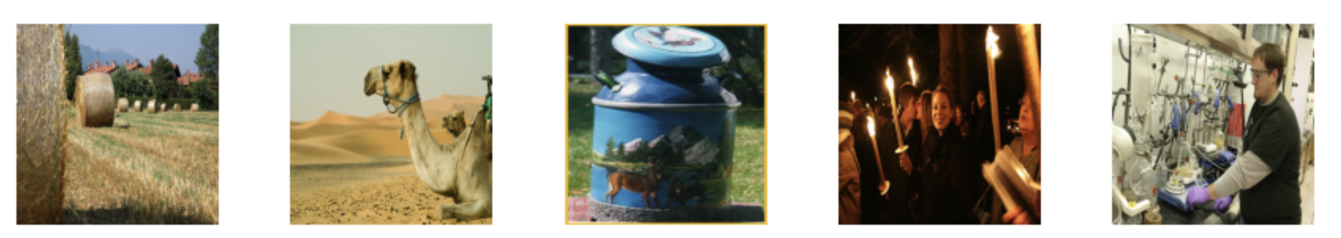
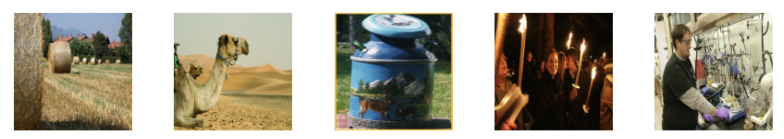
Dataset Preparation
ImageNet
5000 Random sample
Augmentation
Random Horizontal Flip
Dataset
80% Training
20% Validation
Data Set sample
Augmented sample

Slide 9
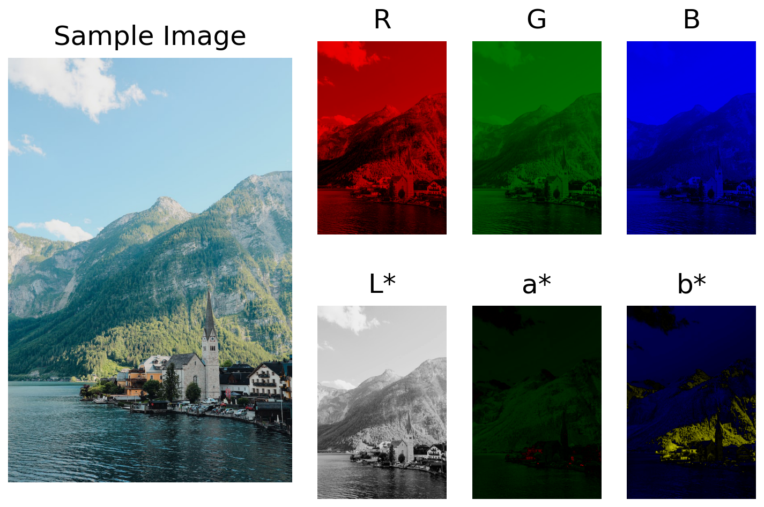
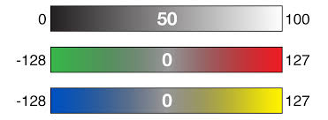
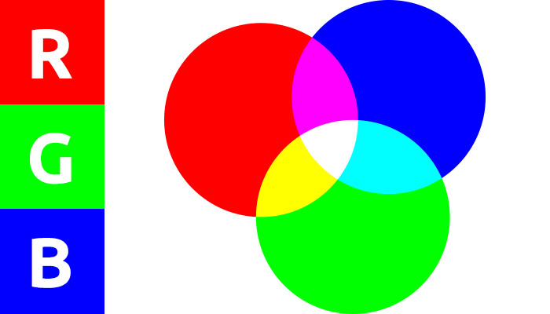
Dataset Preparation
RGB
3 different Channels for red, green, and blue.
LAB
L: Lightening,
a: Green to Red,
b: Blue to Yellow.
Lab
RGB

Slide 10
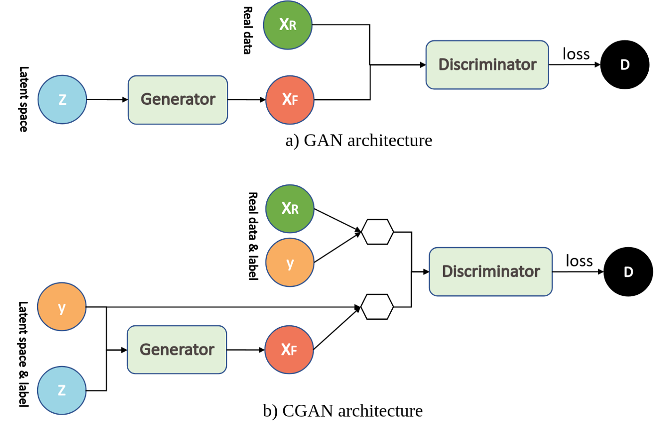
cGAN vs. GAN

Slide 11
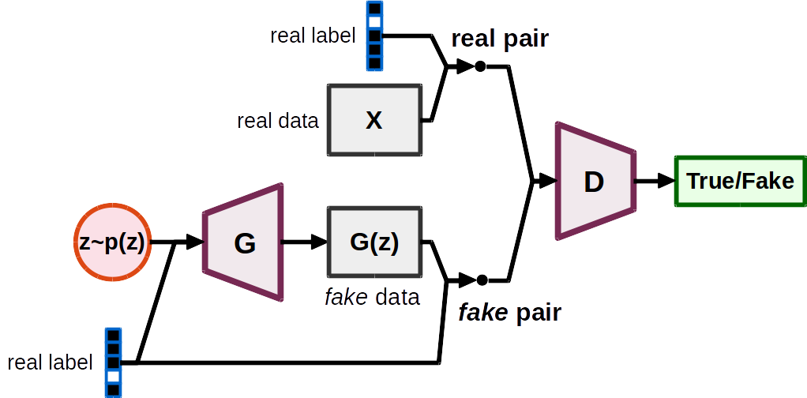
conditional GAN architecture

Slide 12
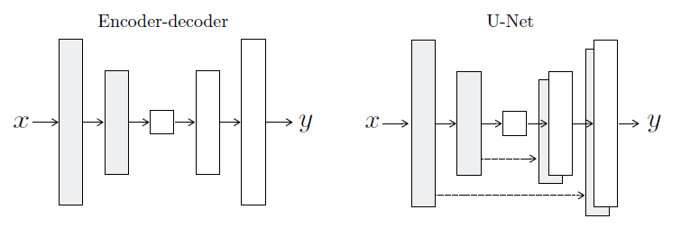
Illustration of UNET and EncoderDecoder architecture
encoder block of the generator network contains the architecture as follows:
C64-C128-C256-C512-C512-C512-C512-C512
In terms of decoder:
CD512-CD512-CD512-C512-C256-C128-C64
The skip connections concatenate activations from layer i to layer n-i. This changes the number of channels in the decoder: UNet
decoder:
CD512-CD1024-CD1024-C1024-C1024-C512 -C256-C128
Most of the convolutional layers will also be followed by the batch normalization layers(except for the first C64 layer).

Slide 13
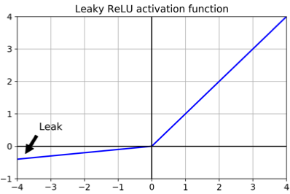
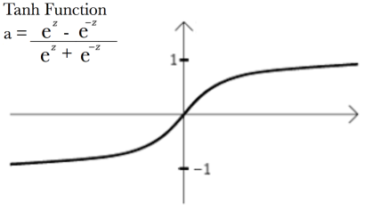
Hyperparameters of UNET
.
Activation function of Generator
Encoder: Leaky ReLU, slope = 0.2
Decoder: Relu, slope = 0.2
We use the hyperbolic tangent (tanh) activation function in the last layer of a U-Net architecture
Rate = 0.5
Dropout

Slide 14
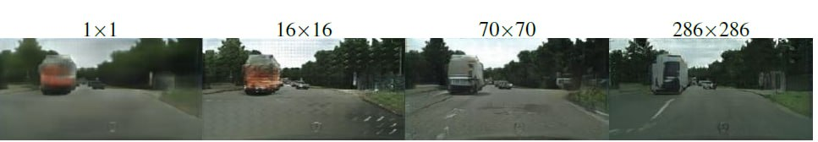

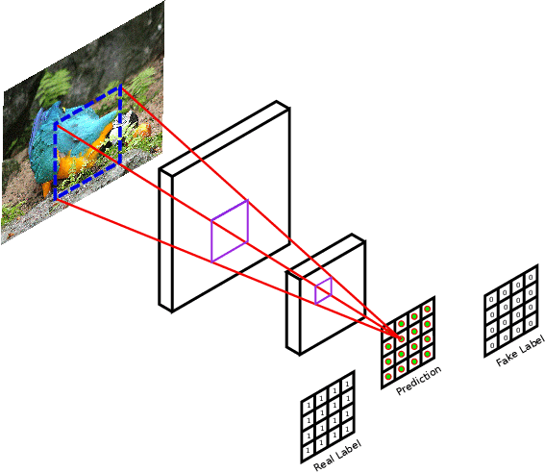
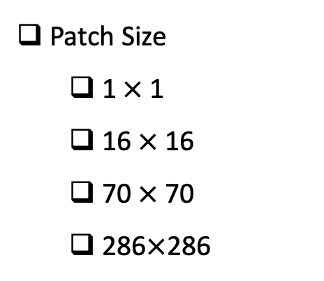
Illustration of PatchGAN
Patch Size
1 $×$1
16 $×$ 16
70 $×$ 70
286$×$286
The discriminator structure will follow the pattern
build of C64-C128-C256-C512
We implement a model by stacking blocks of Conv-BatchNorm-LeackyReLU
Loss
Binary Cross entropy

Slide 15
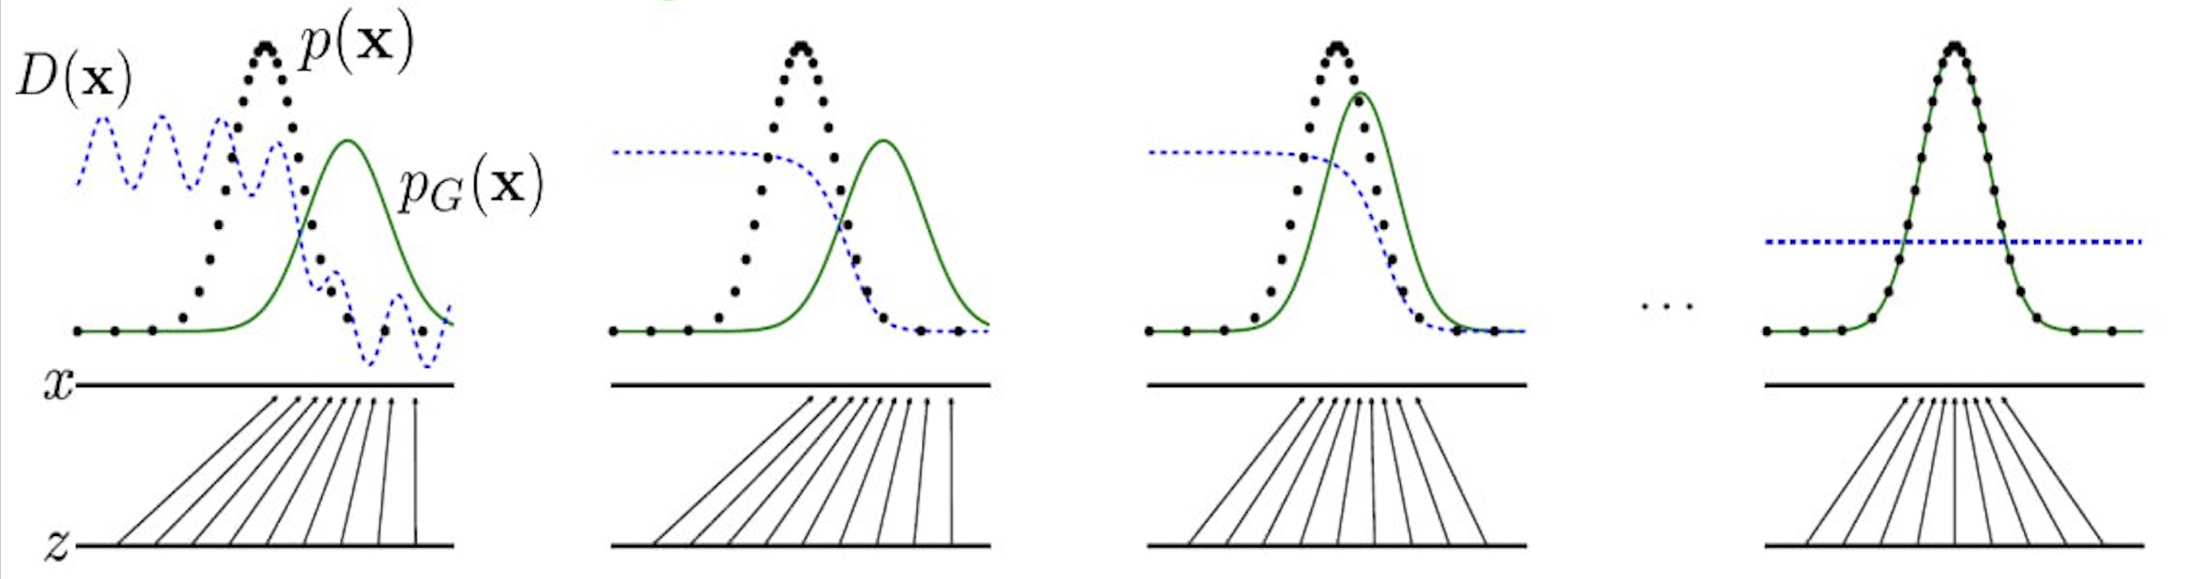
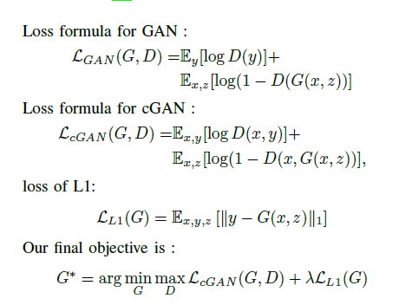
Training process & loss
Optimizer
minibatch SGD , ADAM
λ = 100, β1 = 0.5, β2 = 0.999
Batch size
Size= 16
epoch
Number of epoch= 45

Slide 16
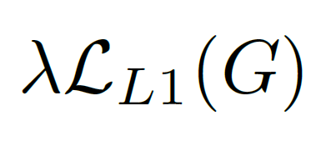
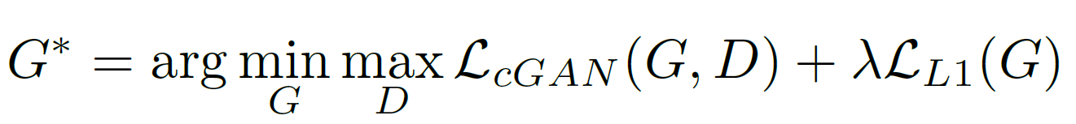
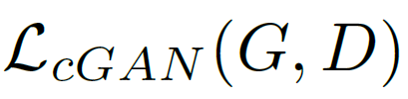
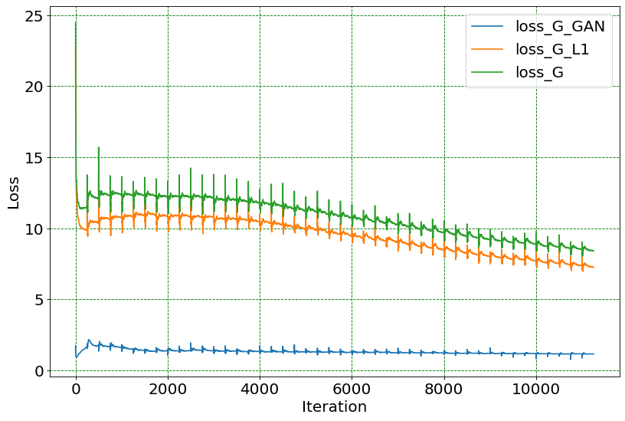
RESULTS
The Generator loss for 45 epochs
loss_G_L1 :
loss_G_GAN:
loss_G:

Slide 17
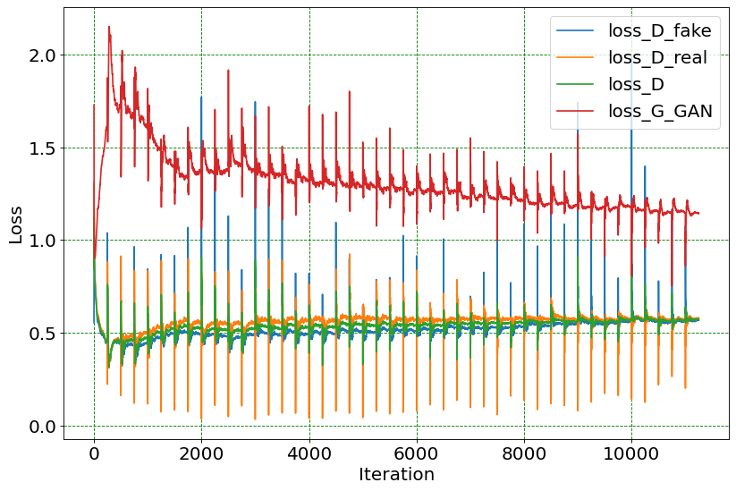
RESULTS
The Discriminator and G GAN loss for 45 epochs

Slide 18
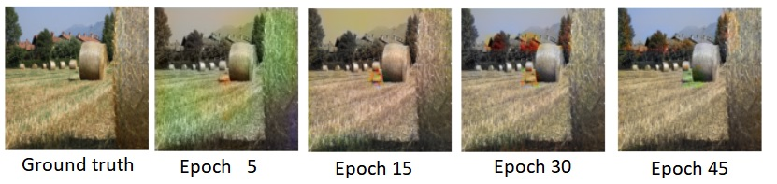
Model Performance of cGAN
Evaluation for 45 epochs.
By increasing the number of epochs can allow the network to learn more complex relationships and generate more realistic colorization.

Slide 19
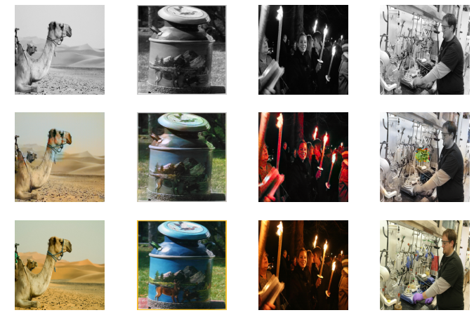
Model Performance of cGAN
Results after 45 epochs
Grayscale
cGan
Ground truth

Slide 20
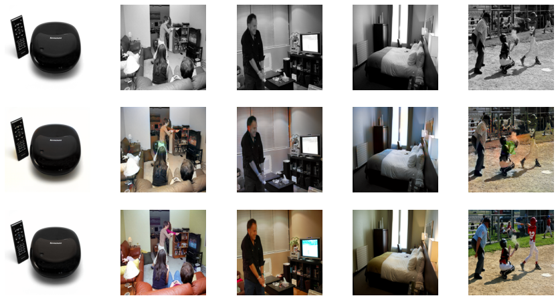
Model Performance of cGAN
Results after 45 epochs for COCO dataset
Grayscale
cGan
Ground truth

Slide 21
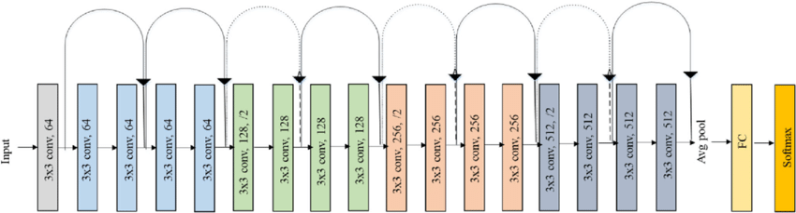
Fine tuning ResNet-18
ResNet-18 is a deep convolutional neural network architecture that was introduced by Microsoft Research in 2015.
The network trained on more than a million images from the ImageNet database for classification task.
Removing the last two layers :
GlobalAveragePooling and a Fully Connected Layer
Use this backbone to build a U-Net as the generator:
2 output channels and 1 input size of 256x256
Train the generator only with L1 loss in 20 epochs (not depends on Discriminator)
Do the same training process with new generator

Slide 22

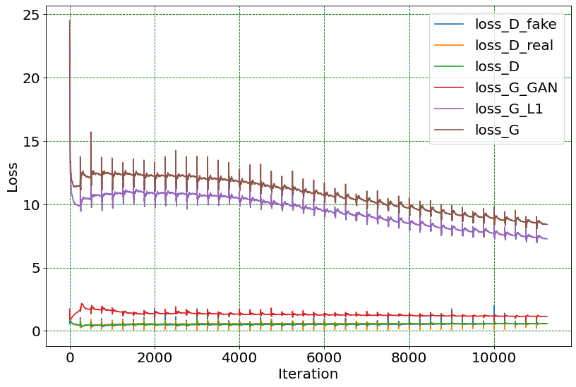
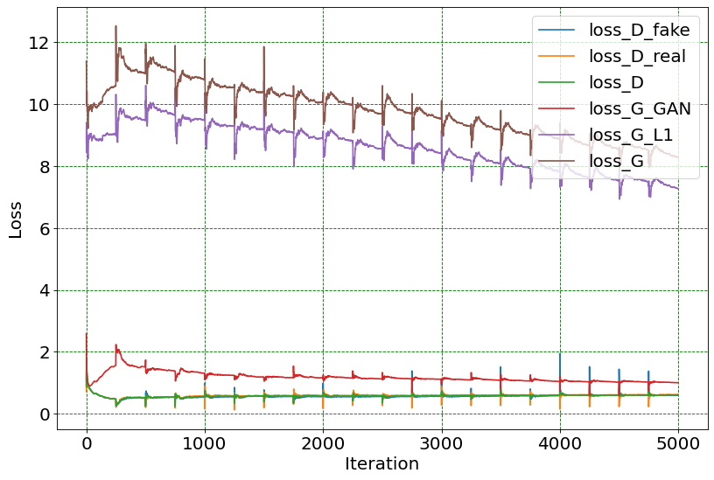
c
COMPARISION:
Main Model
ResNet18 as generator
Losses in 45 epochs
Losses in 20 epochs
.

Slide 23
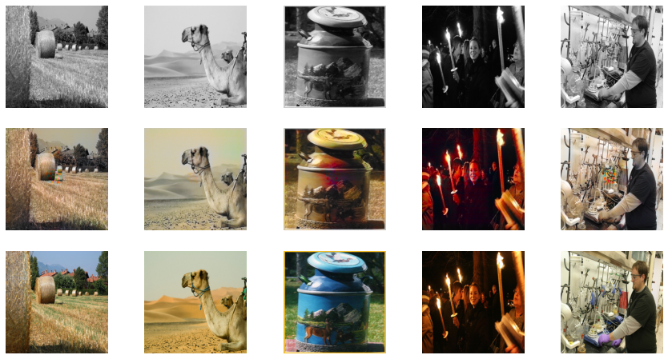
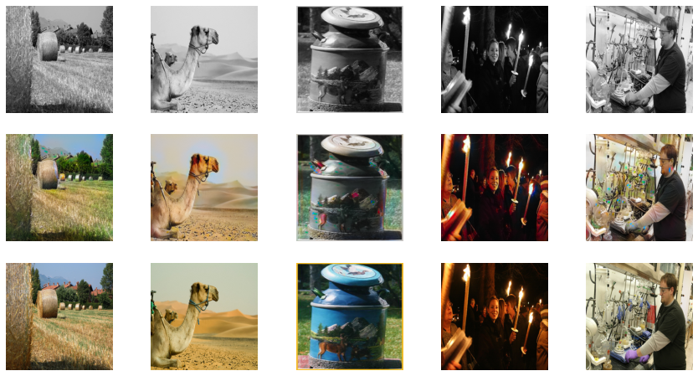
c
COMPARISION:
Main Model
ResNet18 as generator
20 epochs
20 epochs
.

Slide 24
Conclusion
cGan has a good performance, even with small dataset and limited recourses we can get reasonable results
Use Pretrained model as generator in cGan can improve the performance and we can rich better results
With bigger dataset and a greater number of training epochs the results will be more realistic ( which needs more recourses)

Slide 25
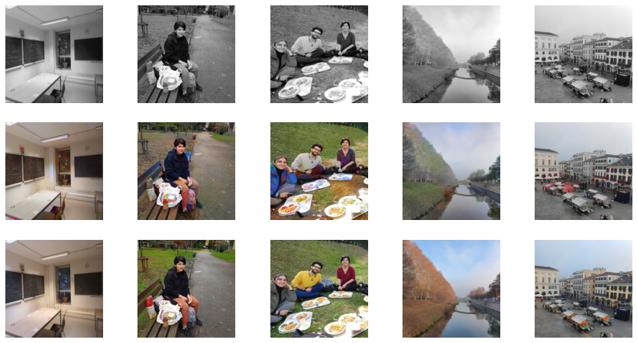
THANK YOU
QUESTIONS ARE WELCOME

